Slide 1
Ray Optics
P47 – Optics: Unit 3

Slide 2
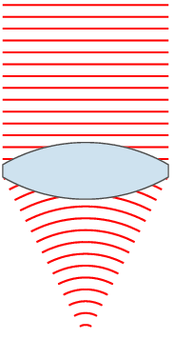
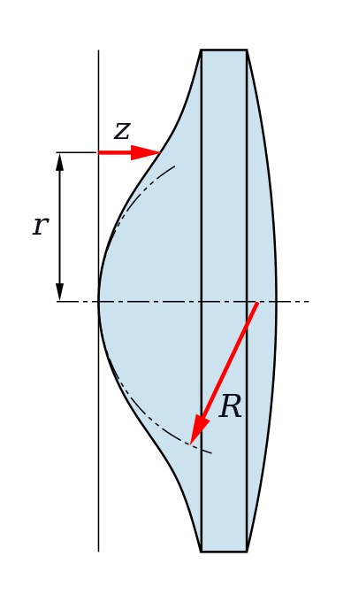
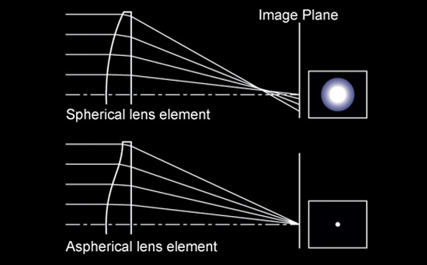
Unit 3
Ideal vs Spherical Lenses

Slide 3
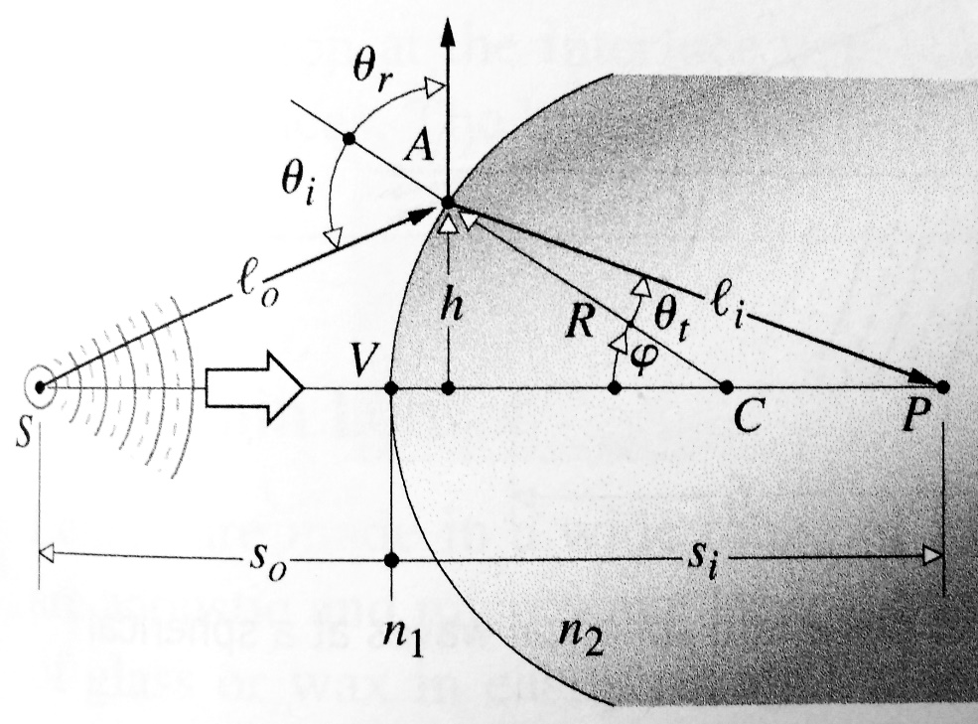
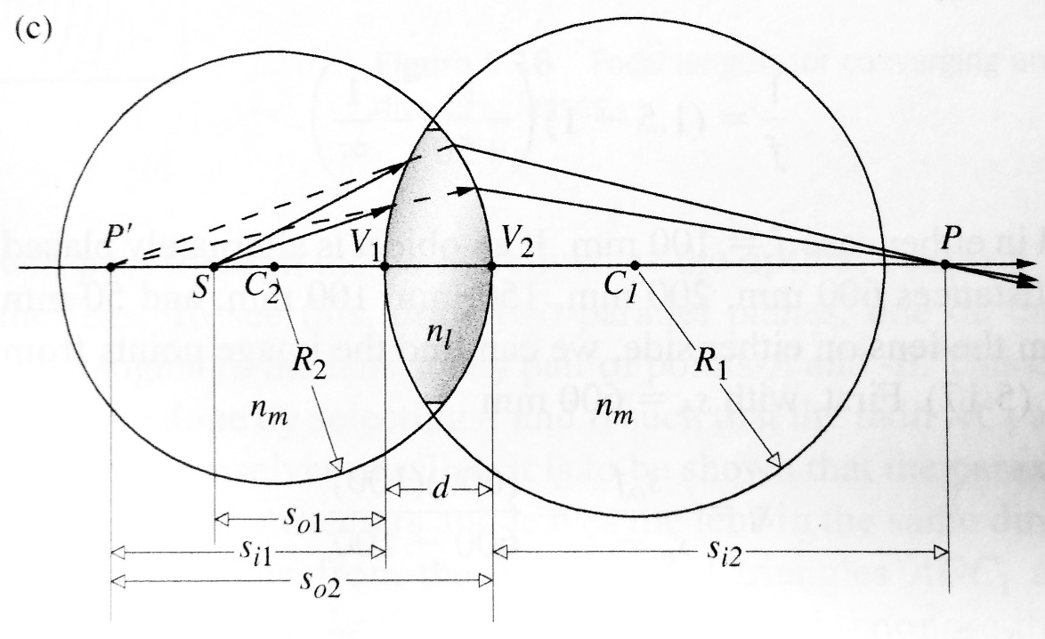
Unit 3
Spherical Lenses
single interface
dual interface

Slide 4
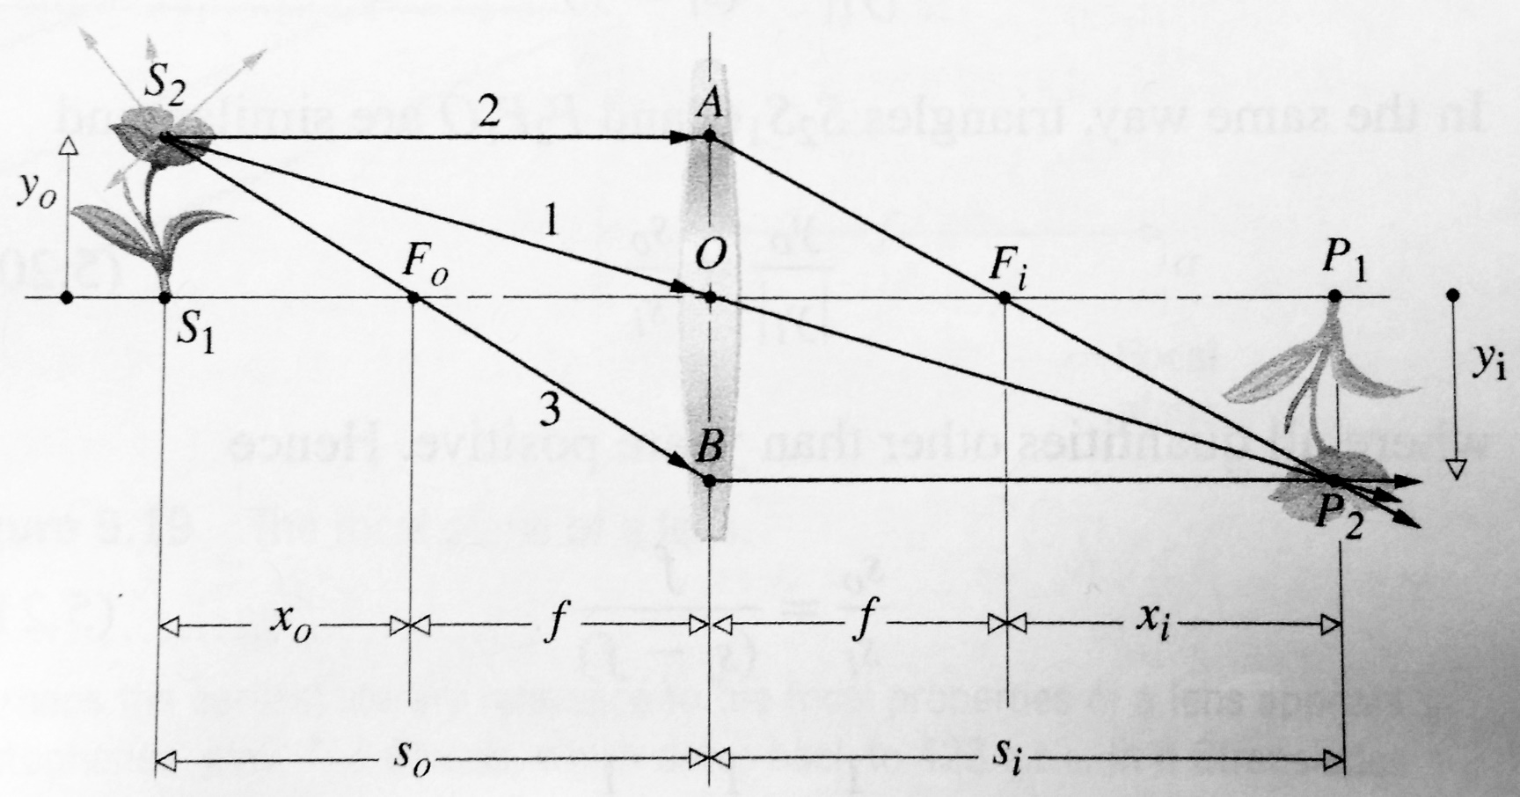
Unit 3
Thin Spherical Lenses

Slide 5
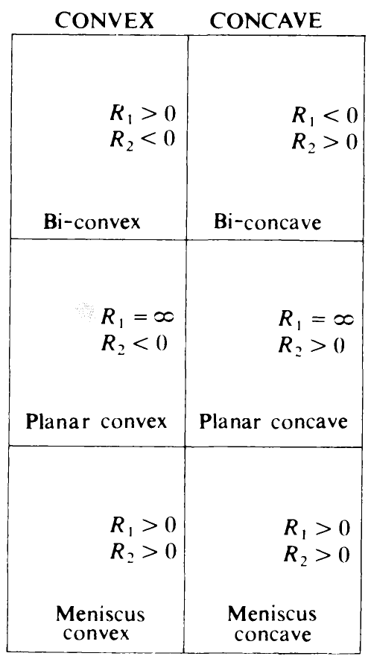
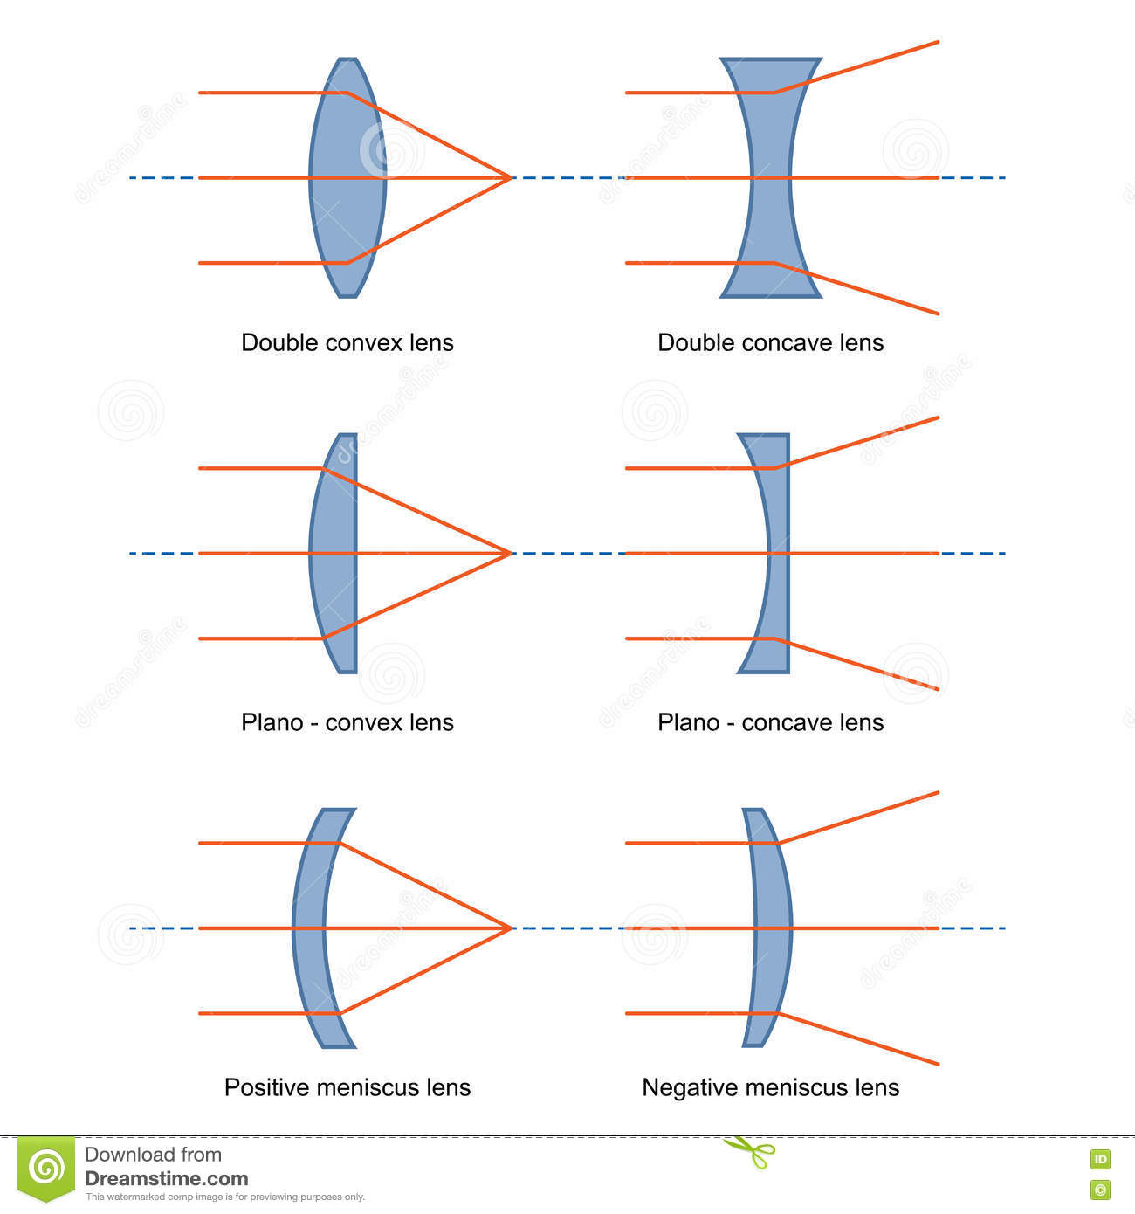
Unit 3
Sign Conventions (lens)
Mirrors:
Concave (R < 0) ; Convex (R > 0)

Slide 6
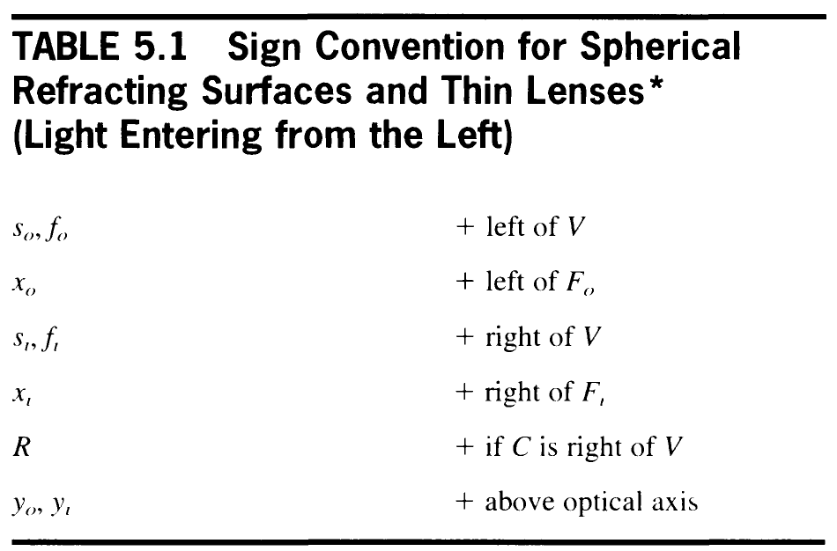

Unit 3
Sign Conventions (lens)

Slide 7
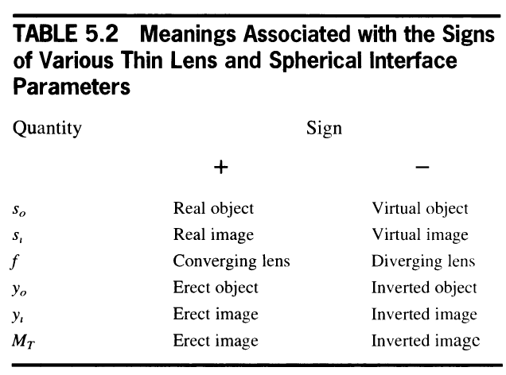
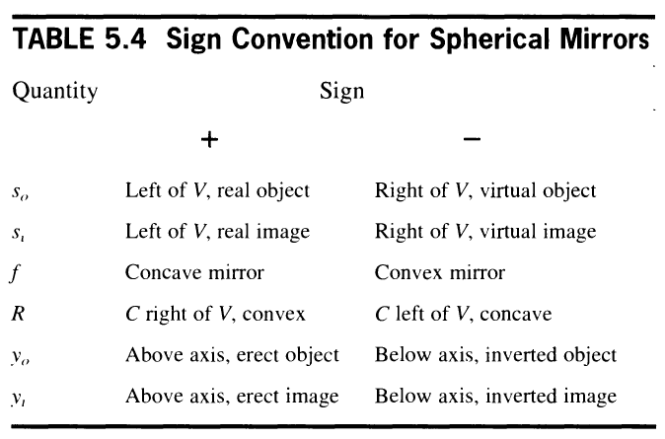
Unit 3
Sign Conventions (real vs virtual)
Lenses
Mirrors

Slide 8
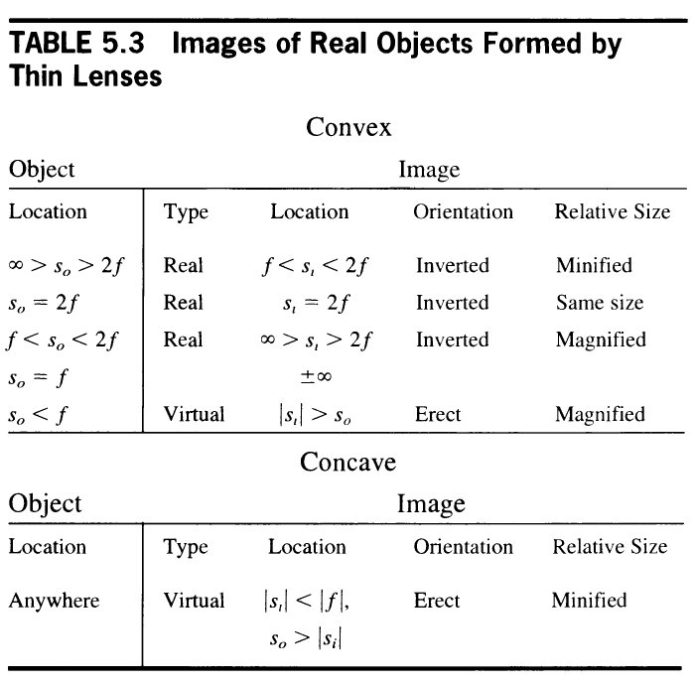
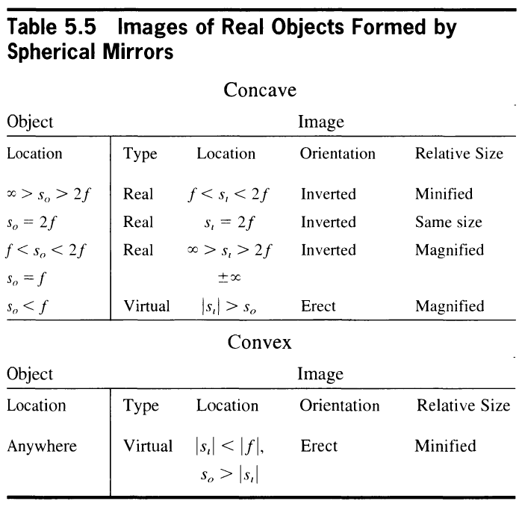
Unit 3
Real vs Virtual & Magnification
Lenses
Mirrors

Slide 9

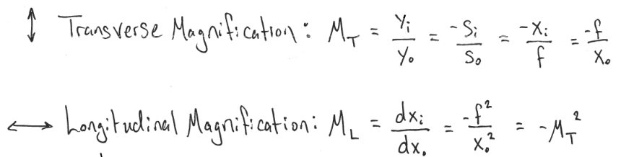
Unit 3
Magnification

Slide 10
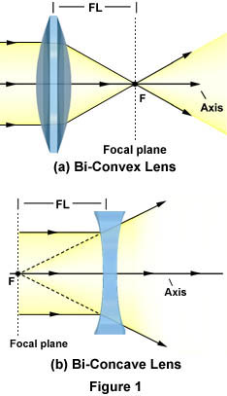
Unit 3
Lens Characteristics
Focal Length
Shape (Aberration)
Diameter (Aperture)
Material (Dispersion)

Slide 11
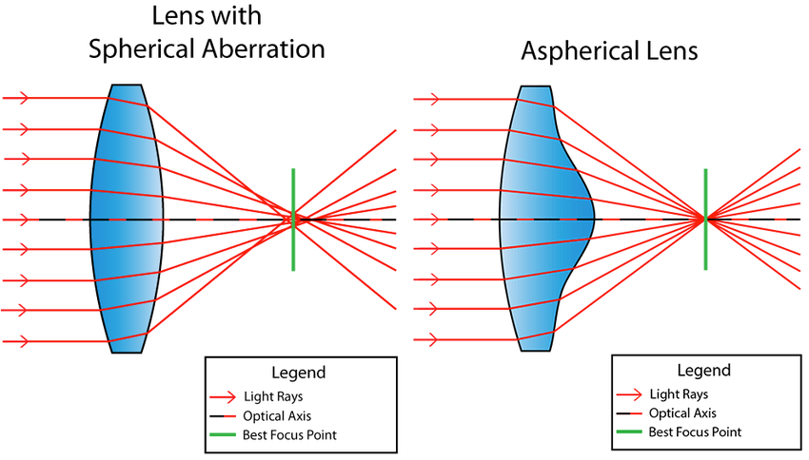
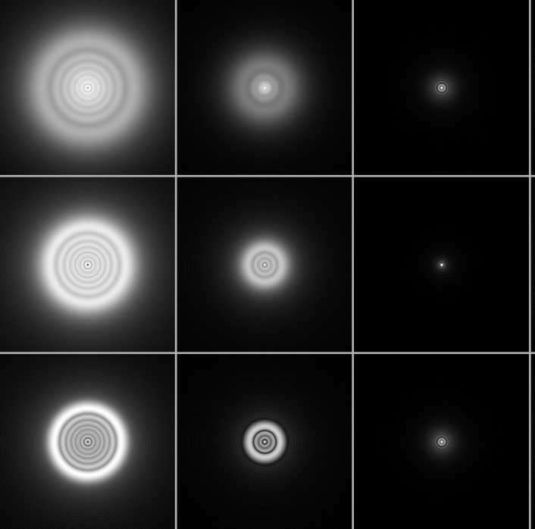
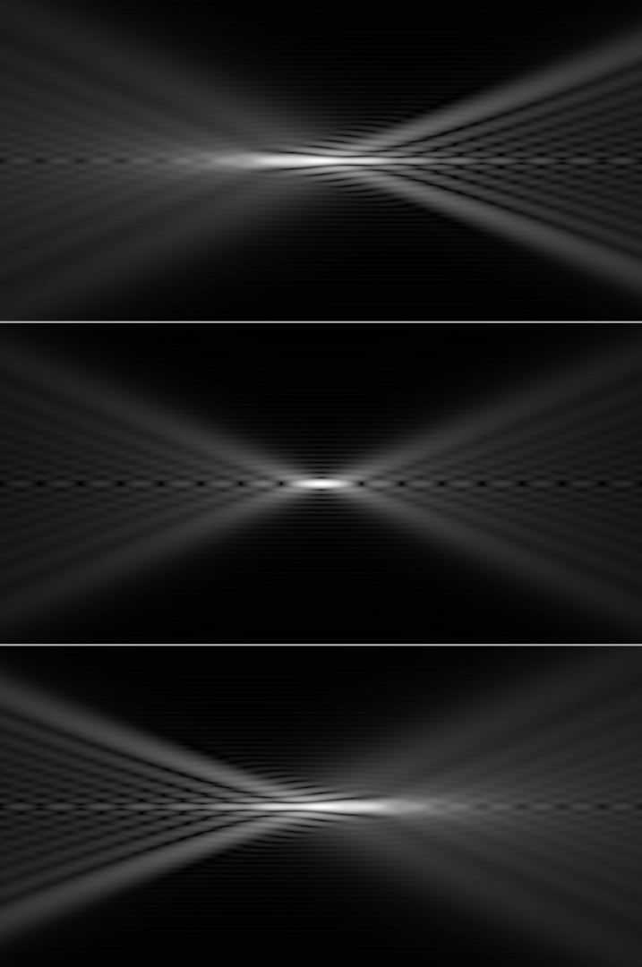
Unit 3
Lens Characteristics: Spherical Aberration

Slide 12
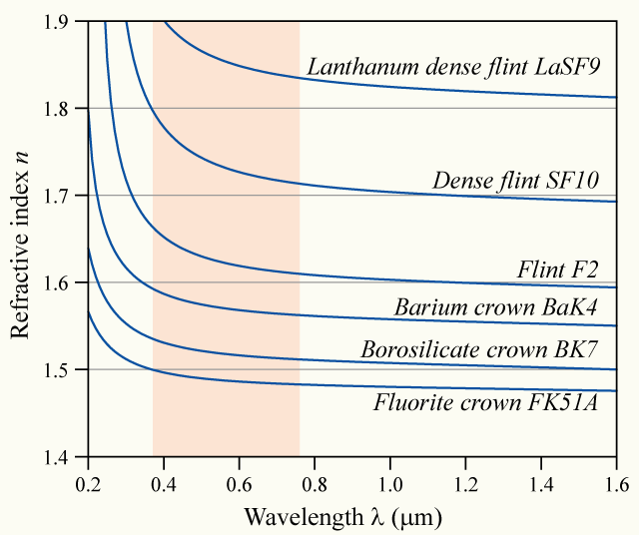
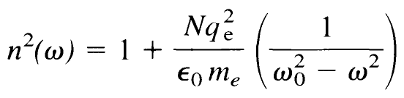
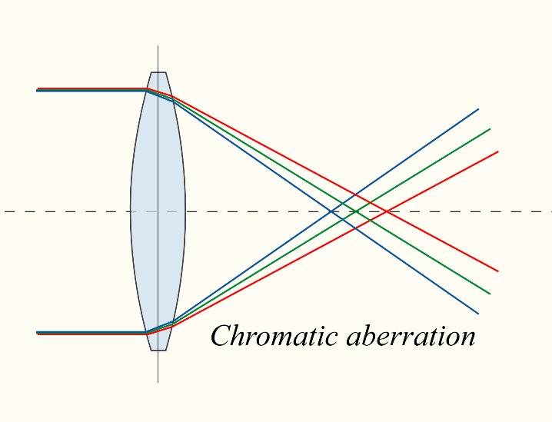
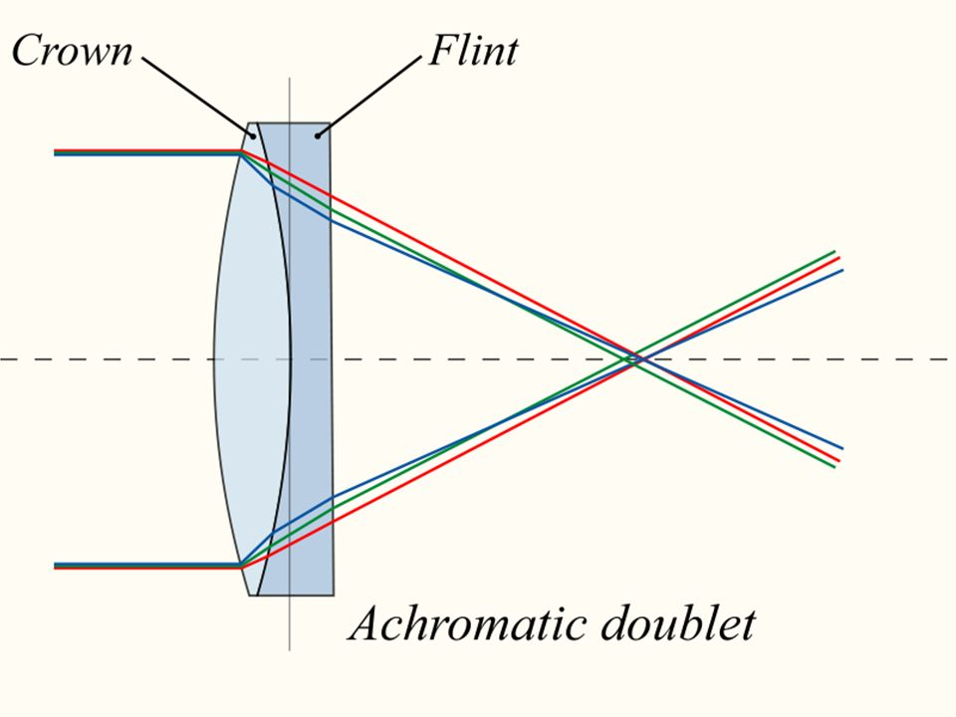
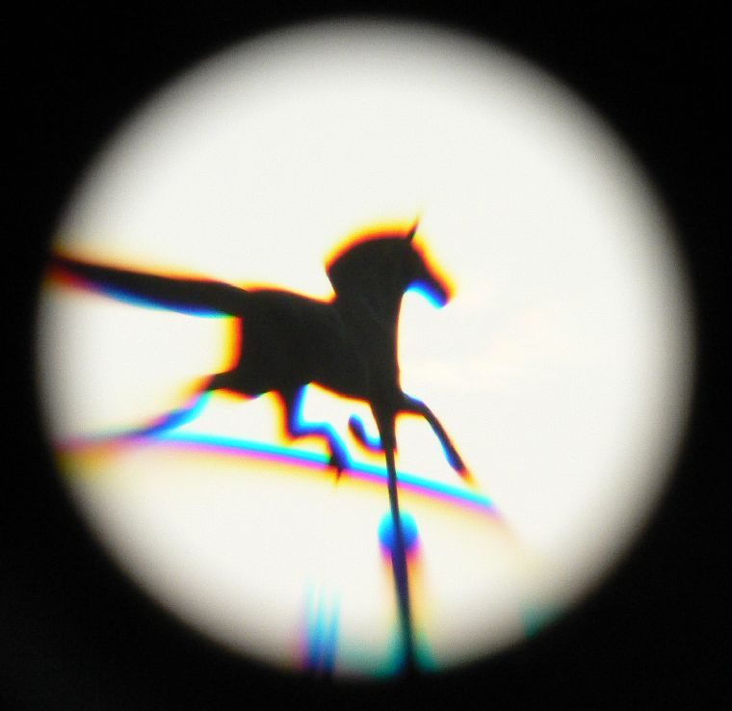
Unit 3
Lens Characteristics: Chromatic Aberration

Slide 13
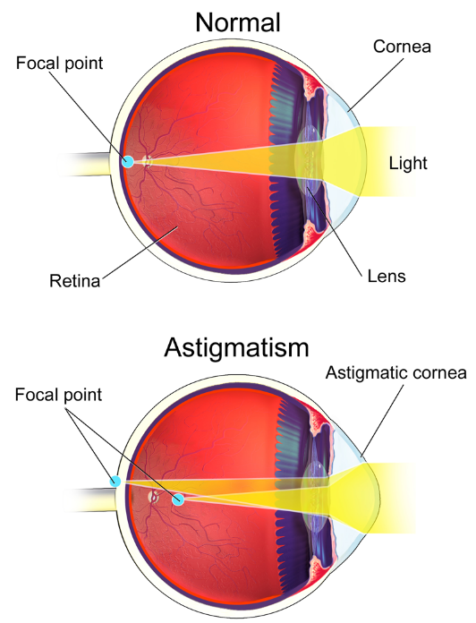
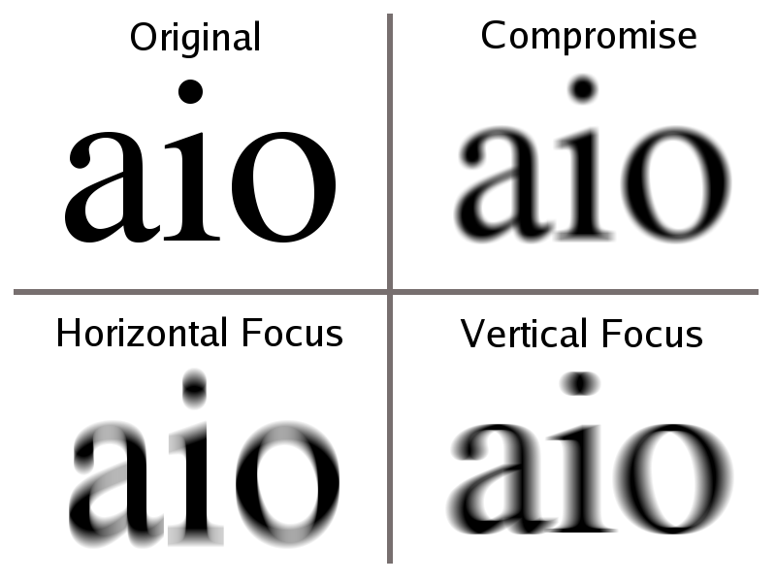
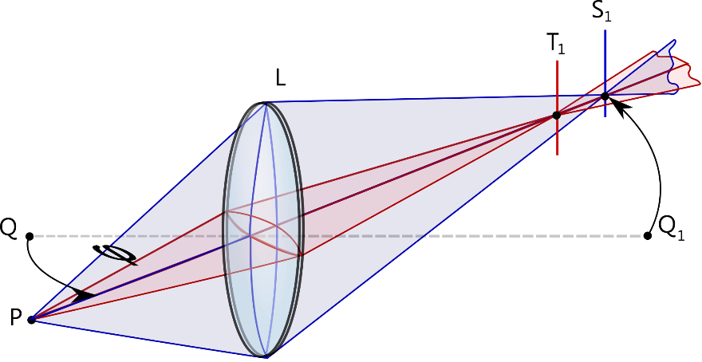
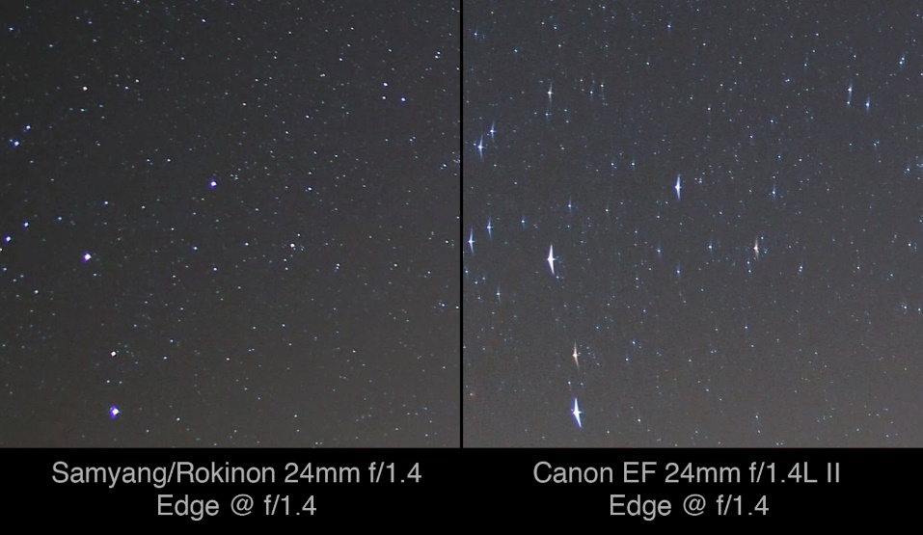
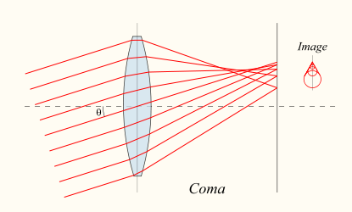
Unit 3
Lens Characteristics: Other Aberrations
astigmatism – lens has angular dependence to focal length
coma – lens has radial dependence to magnification
credit: Royce Bair

Slide 14
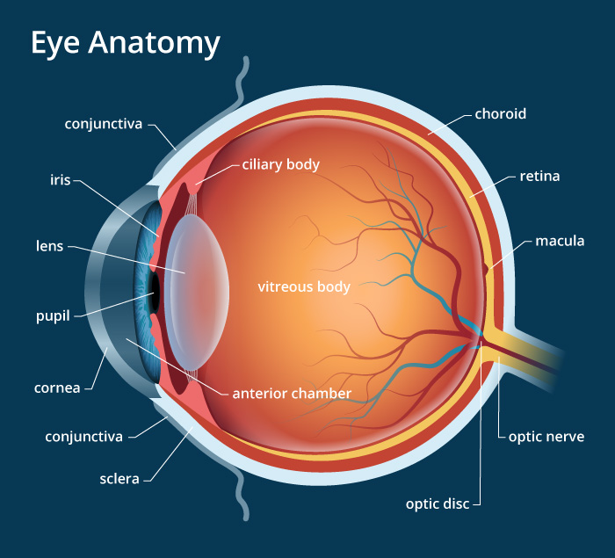
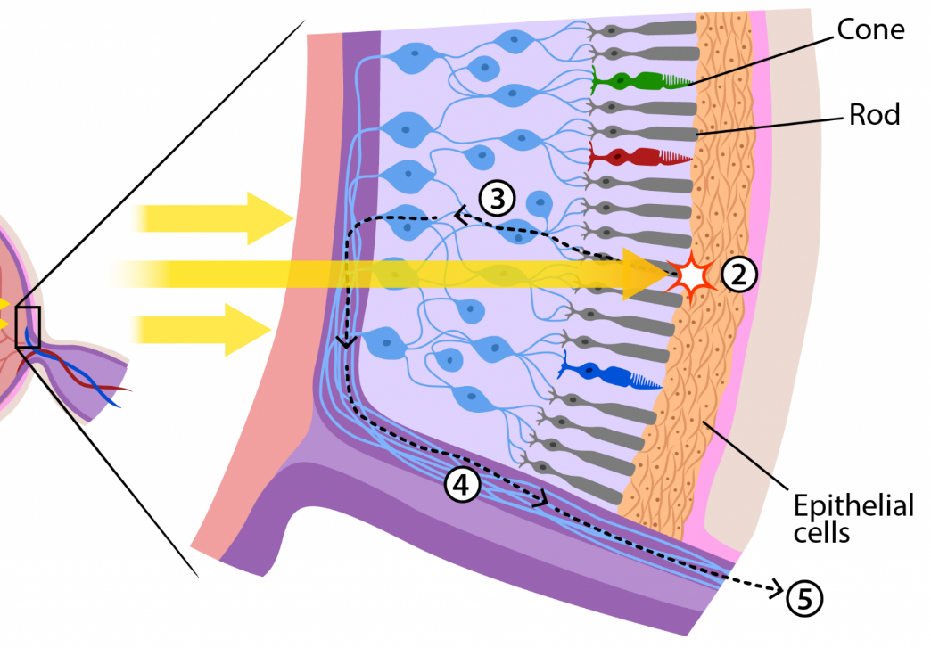
Unit 3
Human Eye

Slide 15

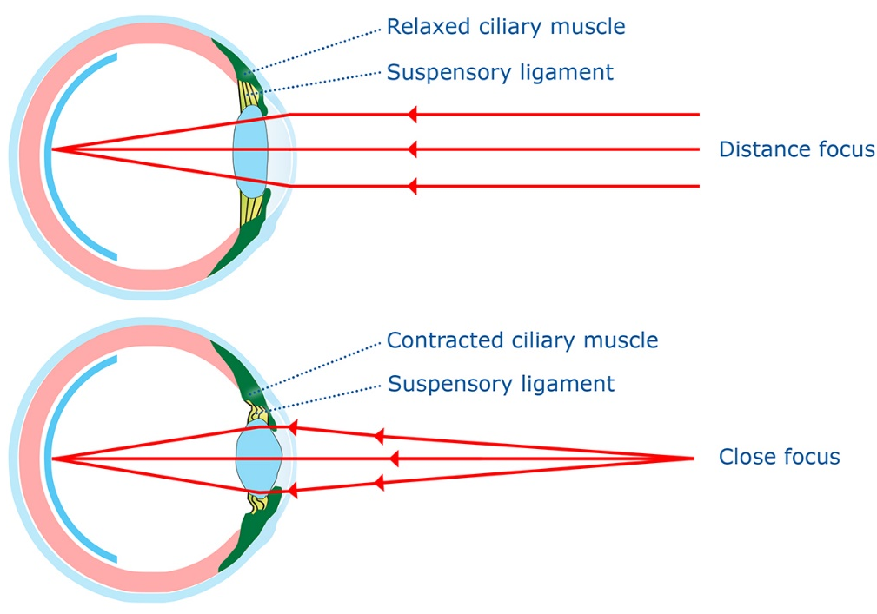
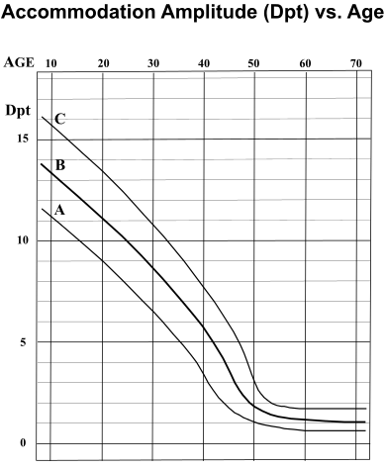
Unit 3
Human Eye – Accommodation
Aging Lens (presbyopia)
Normal Lens
Garner et.al. Clinical and Experimental Optometry 81.4 1998
Duane A, Am J Ophthalmol 5:865, 1922

Slide 16
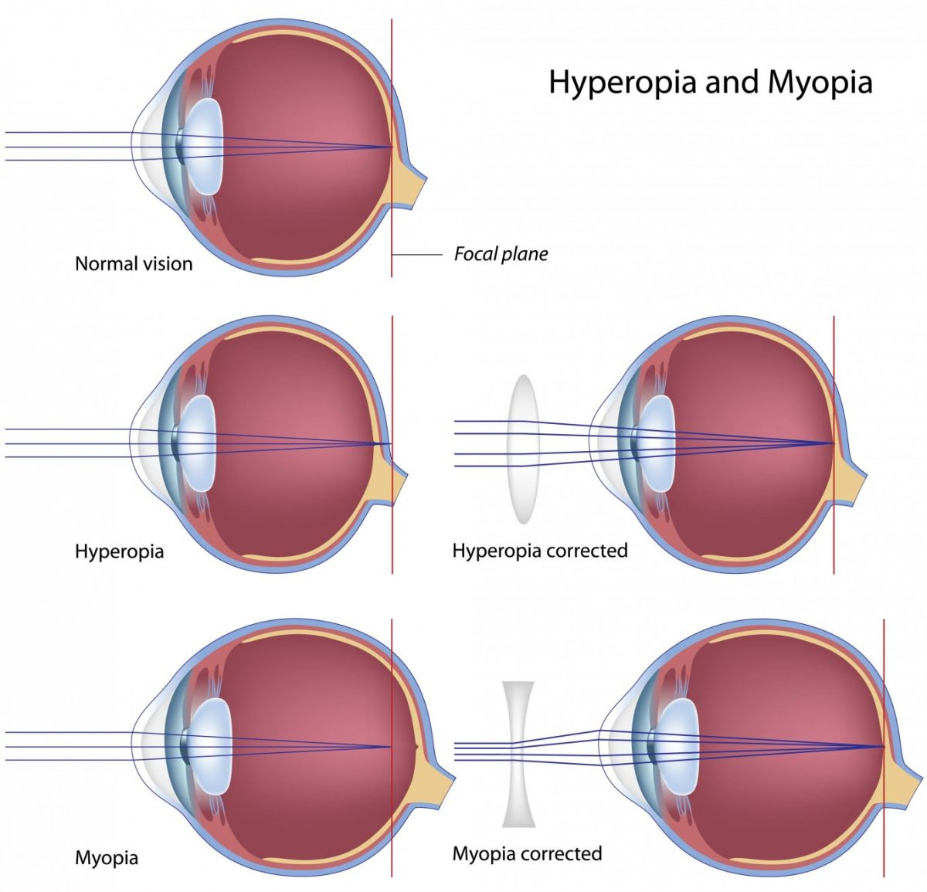
Unit 3
Human Eye – Near vs Far Sighted
(nearsighted)
(farsighted)

Slide 17
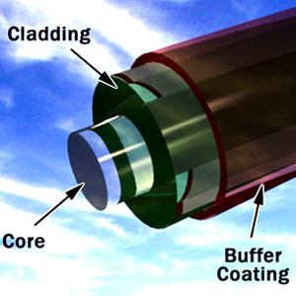
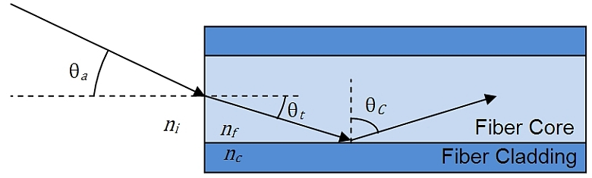
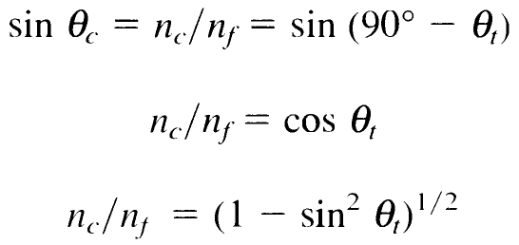
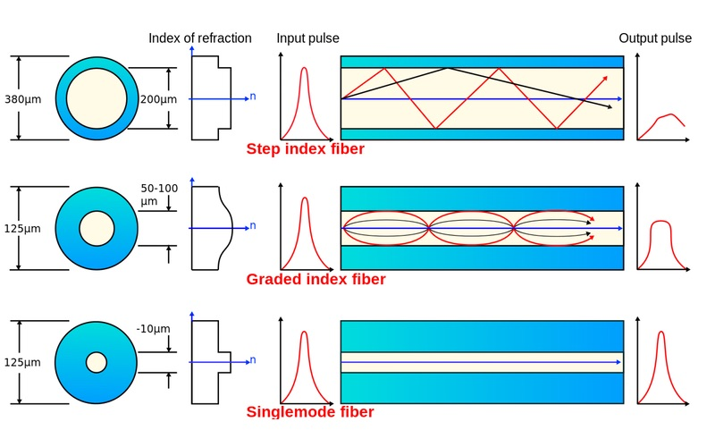
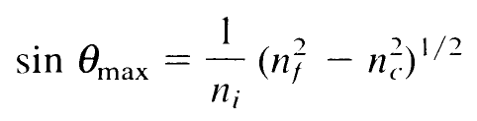
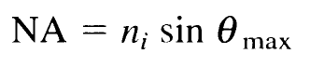
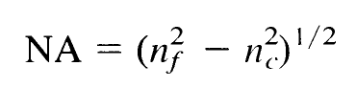
Unit 3
Fiber Optics

Slide 18
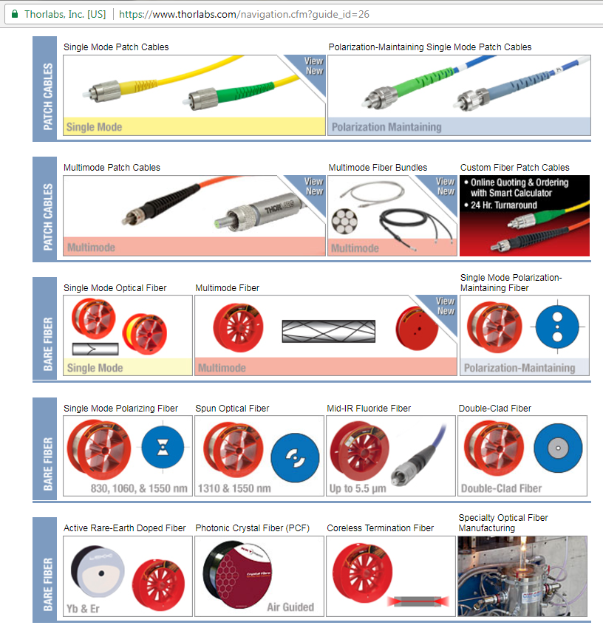
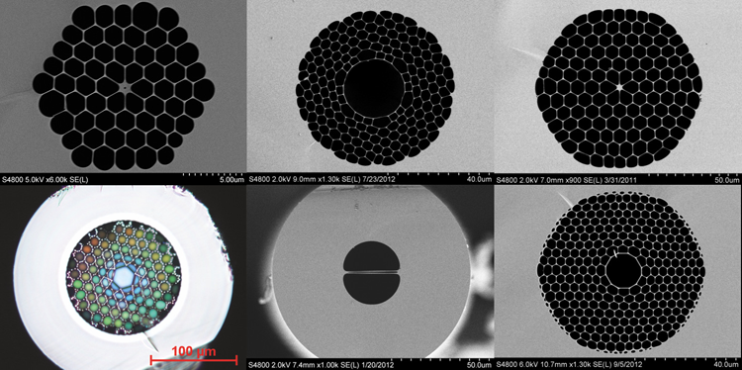
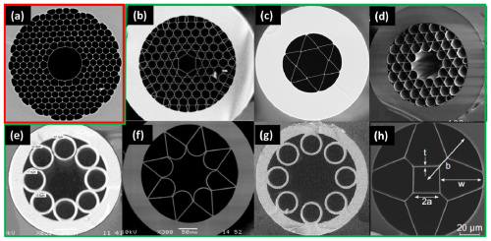
Unit 3
Fiber Optics
credit: Michael Frosz group, Max Planck Institute
F. Poletti, Optics Express, 22, 20, 23807 (2014)

Slide 19
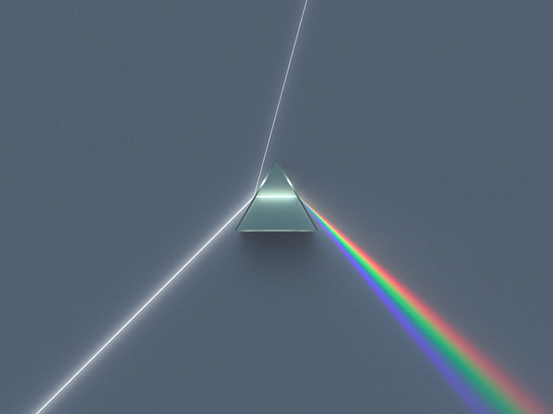
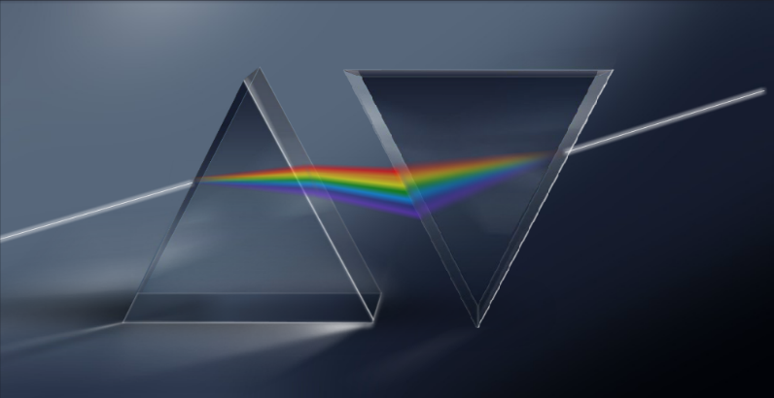
Unit 3
Prisms
Before Newton, was thought that light was colorless and presumed the colored light was generated by the prism
Showed this was not true in two ways:
use a second prism to disperse the red rays → only red transmitted
use a second prism to recollect the dispersed output of the first → white light recovered
Three main types of prisms:
Dispersive
Reflecting / Deflecting
Polarizing

Slide 20
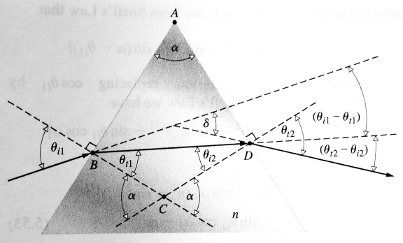
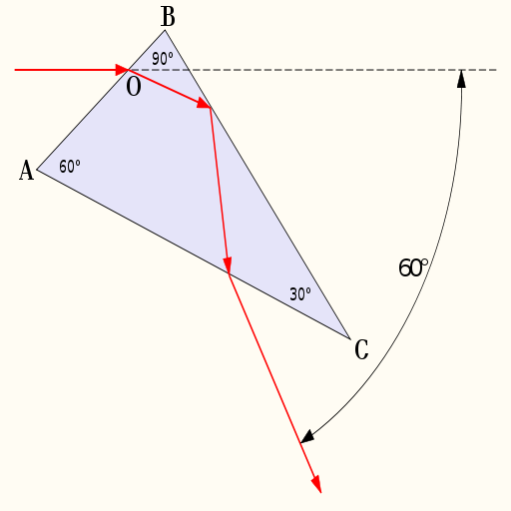
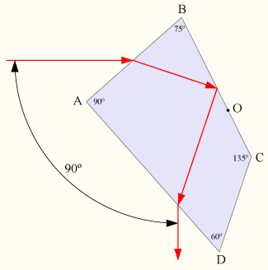
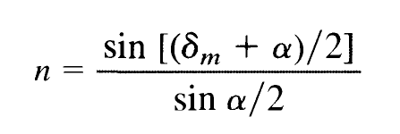
Unit 3
Prisms – Dispersive
Abbe Prism: wavelength selective, only one frequency transmitted at 60° deviation
Triangular Prism: Easily used to determine index of refraction for new materials – just make a prism out of the material!
Pellin-Broca Prism: same as Abbe prism, but transmitted at 90° deviation

Slide 21
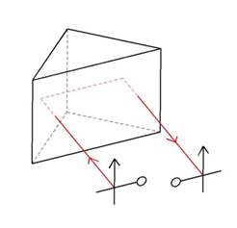




Unit 3
Prisms – Reflective/Deflective
Porro Prism: Uses TIR to rotate image by 180°. Double Porro elements used to completely invert image (in telescopes, binoculars).
Dove Prism: Flips image without beam deviation. Rotating crystal around beam axis rotates output twice as fast – used as a beam rotator.
Penta Prism: Deviates beam by 90° no matter entrance angle. Does NOT use TIR – reflecting faces silvered!
Beam Splitter Cubes: Uses ‘frustrated’ TIR to split incoming beams into two components. Also have “dichroic” beam splitters and “polarizing” beam splitters.

Slide 22


Unit 3
Prisms – Polarizing
can use Brewster’s angle to separate E-field polarization states
more common to use birefringent crystal
different refractive index, n, for p- and s-polarizations
We’ll come back to these when discussing polarization optics!
Wollaston Prism
Nicol Prism

Slide 23



Unit 3
Telescopes
Object at infinity, first image at
Increases angular magnification
Increases apparent brightness of objects (essentially increases diameter of eye)
Three main types of telescopes:
Refracting (lenses)
Reflecting (mirrors)
Catadioptric (combination lenses/mirrors)

Slide 24



Unit 3
Telescopes – Refracting
Galilean Telescope
Keplerian Telescope
credit: Don Bruns

Slide 25


Unit 3
Telescopes – Reflecting
Much longer focal length gives more angular magnification
Are much more compact than refracting telescope of similar power
Easier to manufacture large diameter mirrors than lenses
Mirrors are free of chromatic aberration (Newton’s motivation for invention!)
Newton’s First Reflecting Telescope

Slide 26



Unit 3
Telescopes – Catadioptric
Schmidt-Cassegrain Telescope
credit: Glenn @ sfastro.net

Slide 27


Unit 3
Telescopes – The Hubble
D = 4.9 m
R2 = 1.36 m
R1 = 11.04 m
Ritchey-Chretien Cassegrain

Slide 28



Unit 3
Telescopes – Diameter Comparison
Keck Observatory – Hawaii
Extremely Large Telescope – Chile (planned)

Slide 29



Unit 3
Thick Lenses
Distance measurements now with respect to Principal Planes and Points (P₁, P₂ and H₁, H₂)
Angles measurements now found using Nodal Points
By knowing Focal Points, Principle Points, and Nodal Points, can calculate rays for any thick lens system
These 6 pts are the Cardinal Points

